Slide 1
Intro to Swift & iOS
John Crowson
Chris Longe
Notes:
Over 25% of the iOS App Developers earn over $5,000 from their app

Slide 2
Agenda
Intro to the Swift programming language
Intro to iOS
Quiz (Prizes?!)
Building a notes app using Xcode 10
Pair programming!

Slide 3
Prerequisites
macOS 10.13.6 + (High Sierra +)
Xcode 10 +

Slide 4

Swift

Slide 5

Swift is a relatively new programming language for iOS, macOS, watchOS, and tvOS app development.
Notes:
Create one model, use across several platforms
Over 25% of the iOS App Developers earn over $5,000 from their app
Swift developers are in high demand - capital one uses swift for all new iOS development
It’s an easy to learn for new developers, provides safety mechanisms against common pitfalls like null pointer exceptions, provides automatic memory management.

Slide 6
Swift Evolution
June 2014
Sept 2014
June 2015
Dec
Sept 2016
Sept 2017
beta
1.0
2.0
open-sourced
3.0
4.0
4.1
4.2
Sept 2018
Notes:
Before iOS: Objective-C
Open source - can propose features
more recently, Swift has been made available on other platforms like building APIs.
Advantages:
disadvantages: Moving target -- Code Migrations, Stack Overflow

Slide 7
Getting our feet wet
Xcode -> “Get started with a new playground”

Slide 8
Swift is Value-Oriented
Values 😍
Swift is an aggressively value-oriented language, it uses value types rather than reference types for nearly everything.
structs, bools, integers, floats, strings, arrays, dictionaries, and sets are all implemented using value semantics
A value type is something that only ever has one unique owner
In contrast, classes are reference types in Swift
This means that the same object can have multiple owners, and if any of them change the value then it changes everywhere
Always remember, structs pass by value and classes pass by reference

Slide 9
iOS Programming

Slide 10
MVC
Apple’s preferred software architecture
Stands for Model View Controller
It is by far the most common design pattern when working on iOS, macOS, or tvOS
Models are structs or classes holding a handful of properties
Views almost exclusively deal with UIKit
Controllers contain everything else

Slide 11
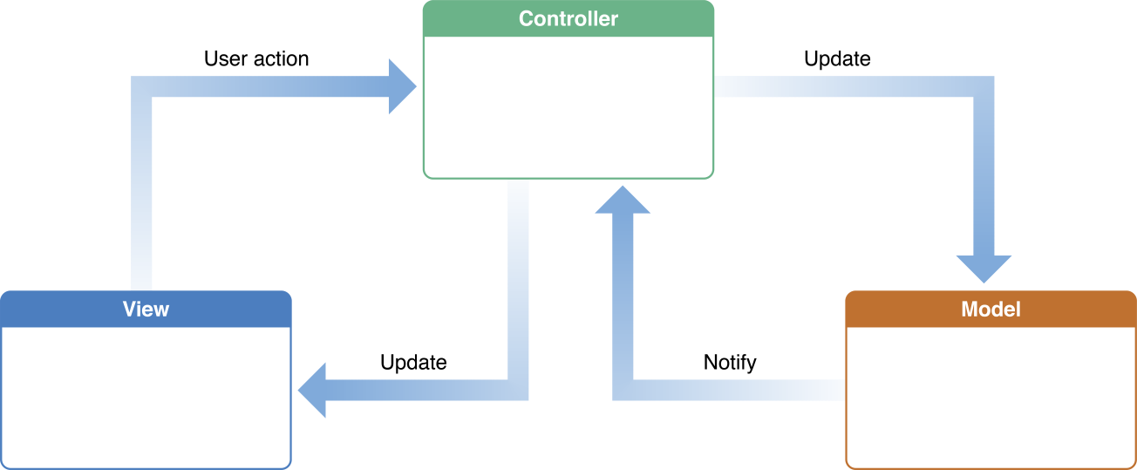
MVC Design Pattern
@IBAction
@IBOutlet

Slide 12
Controller Lifecycle
UIViewController
The UIViewController class (and its subclasses) come with a set of methods that manage view hierarchy. iOS automatically calls these methods at appropriate times when a view controller transitions between states.
viewDidLoad() - called once when you create the view controller. Great for initial setup and one-time only work.
viewWillAppear() - called right before your view appears. This gets called everytime your view is about to appear.
viewDidAppear() - called after the view appears. This gets called everytime your view has appeared.
viewWillDisappear()
viewDidDisappear()

Slide 13
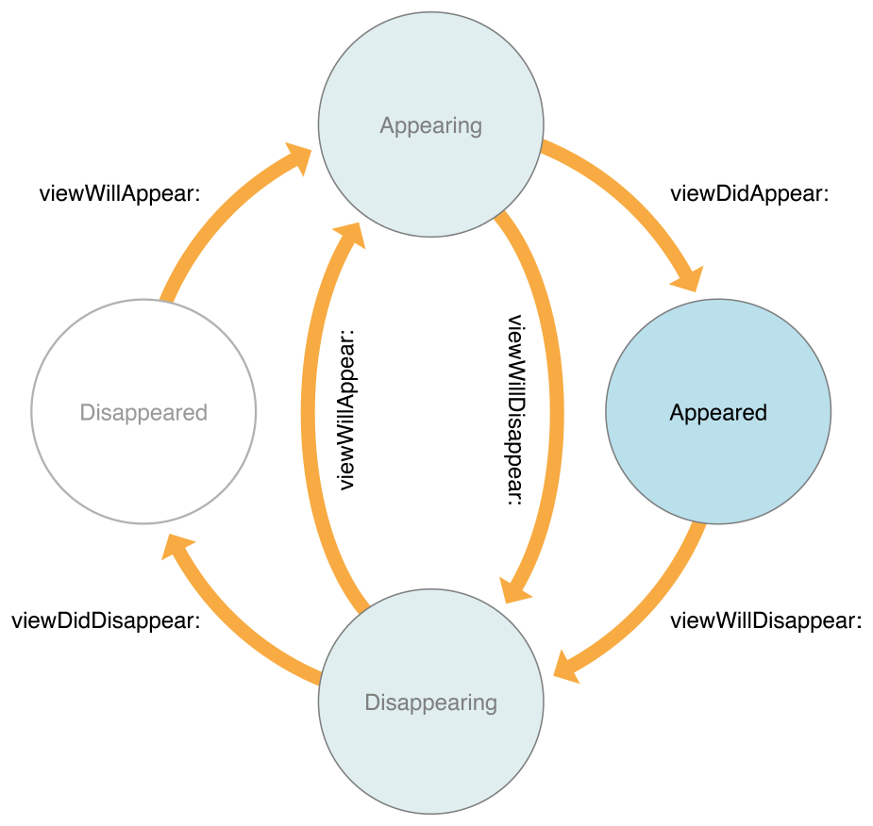
Valid State Transitions

Slide 14
Quiz

Slide 15
Quiz Time
www.kahoot.it

Slide 16
GitHub Repo
github.com/
C1-SoftwareEngineeringSummit/
Notes-App

